Slide 1

Optimizing Food Delivery Time Prediction
Inaccurate delivery estimates plague food delivery platforms, leading to customer dissatisfaction and operational inefficiencies. This project focuses on developing a robust machine learning solution to predict delivery times more accurately, enhancing customer trust and streamlining logistics.

Slide 2

INSIGHT
The Challenge:
Inaccurate ETAs
Food delivery platforms frequently struggle with unreliable estimated arrival times (ETAs).
Late deliveries erode customer trust and loyalty.
Inaccurate predictions negatively impact platform ratings and reviews.
Operational disruptions and increased customer support inquiries.
Our solution aims to transform this challenge into a competitive advantage.

Slide 3

SOLUTION OVERVIEW
Predicting Delivery Time: Key Operational Factors
Our predictive model leverages several critical operational factors to forecast delivery times accurately.
1
2
Distance to Customer
Delivery Partner Profile
The geographic distance between the restaurant and the delivery location.
Factors related to the rider, including historical performance and efficiency.
3
4
Order Type
Vehicle Type
Characteristics of the order itself (e.g., small, large, complex items).
The mode of transportation used for delivery (e.g., car, scooter, bike).

Slide 4
BUSINESS IMPACT
Driving Value: Enhanced Reliability and Efficiency
Accurate ETAs translate directly into tangible business benefits across the platform.
Higher Customer Satisfaction
Better Rider Allocation
Reliable predictions foster trust and improve the overall user experience, leading to repeat business.
Optimized dispatching and routing based on precise ETAs, maximizing delivery efficiency.
Reduced Cancellations
Improved Platform Reliability
Fewer surprises mean fewer last-minute order cancellations, preserving revenue.
A more predictable service builds a strong reputation and competitive advantage in the market.

Slide 5
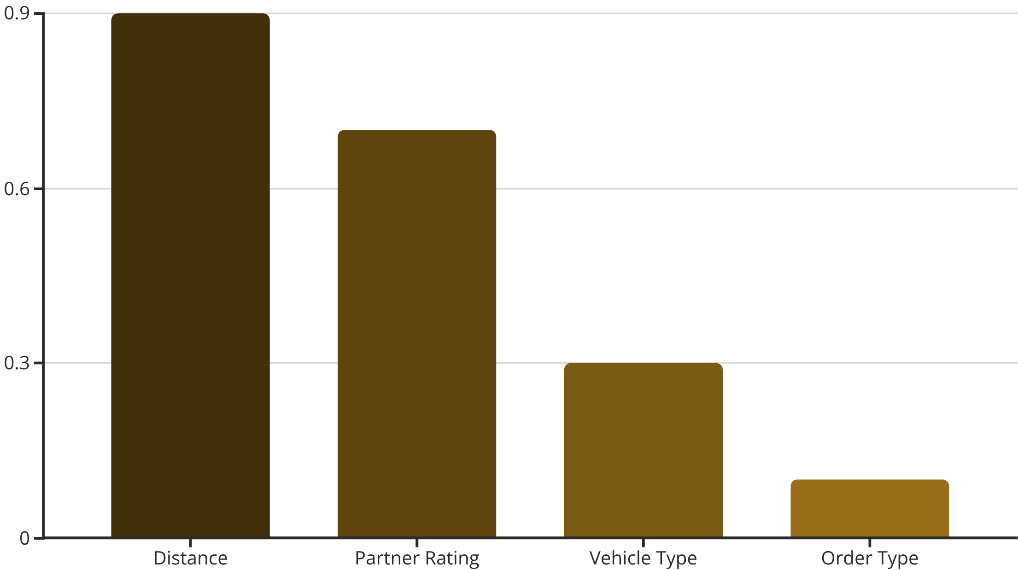
DATA INSIGHTS
Dataset Overview & Feature Importance
Our analysis revealed key insights into the factors driving delivery times:
Target Variable: Delivery Time (minutes)
Features: Distance, Partner Ratings, Partner Age, Order Type, Vehicle Type, etc.
Key Observations:
Distance is the strongest predictor of delivery duration.
Delivery partner ratings significantly influence performance.
Order type and vehicle type have a comparatively minor impact.

Slide 6
METHODOLOGY
Feature Engineering & Preprocessing Steps
Rigorous data preparation is crucial for model accuracy and reliability.
01
02
Handling Missing Values
One-Hot Encoding
Strategically imputed or removed incomplete data points to maintain dataset integrity.
Converted categorical variables into a numerical format suitable for machine learning models, dropping redundant categories.
03
04
Train-Test Split (80-20)
Interaction Feature: Distance x Rating
Divided data into training and validation sets to ensure unbiased model evaluation.
Created a new feature to capture combined effects of distance and delivery partner efficiency.

Slide 7
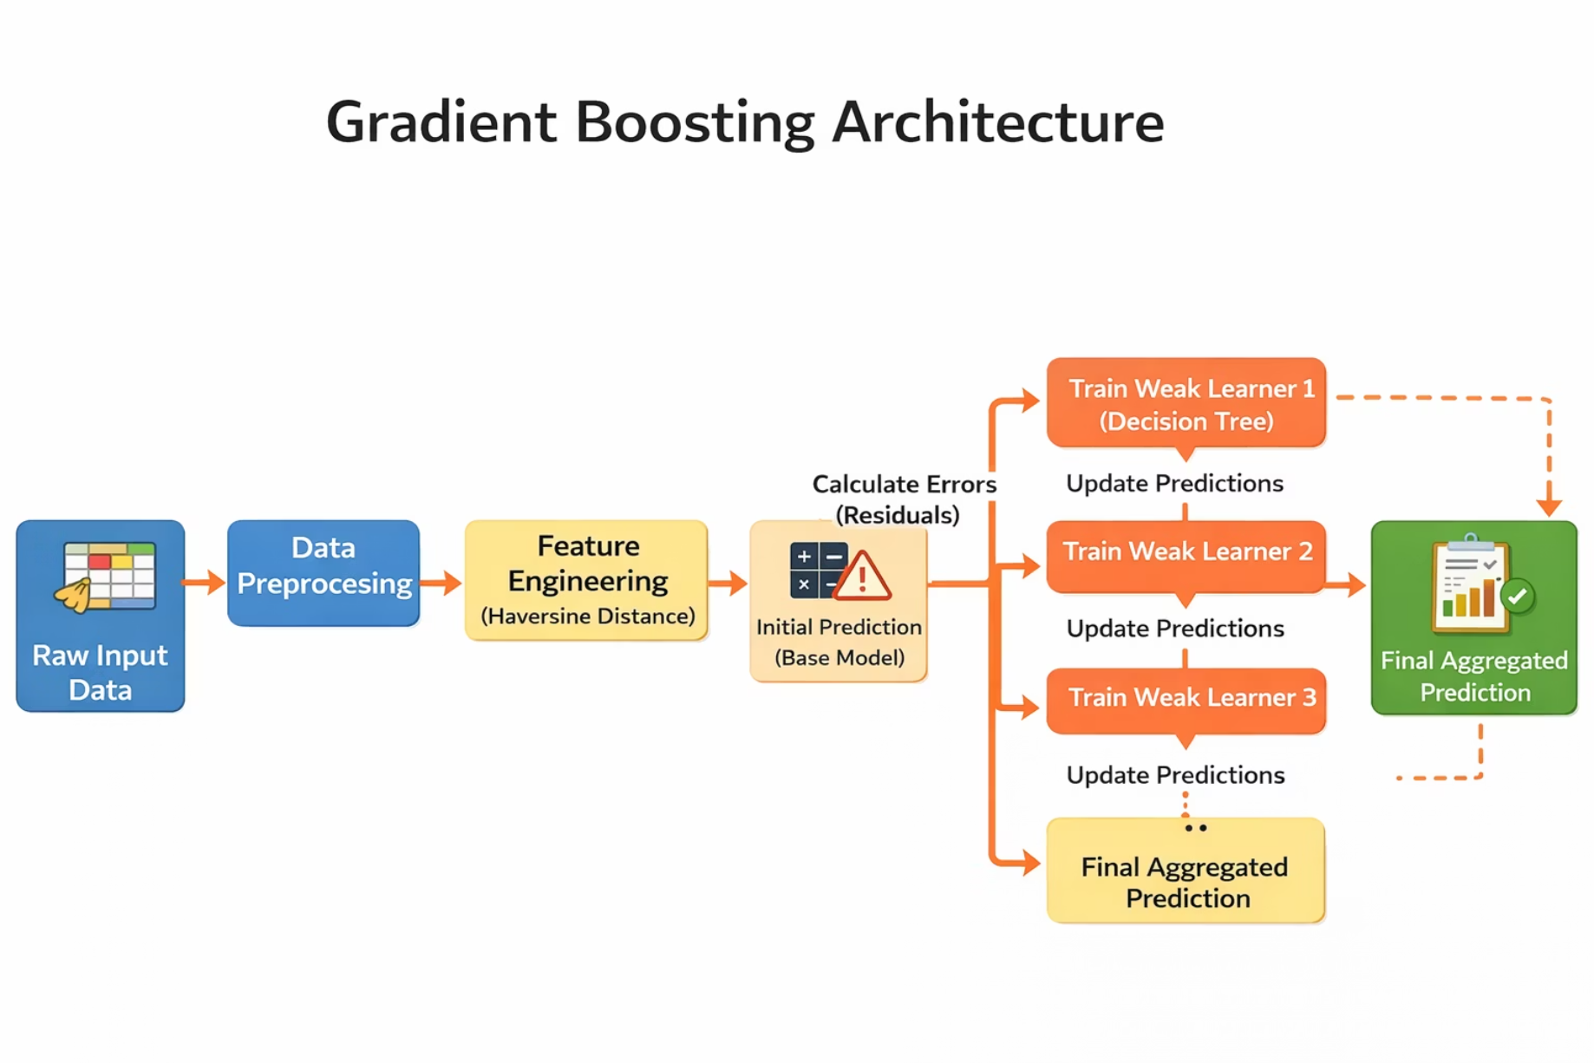
MODEL SELECTION
Gradient Boosting: Our Chosen Architecture
After experimenting with various models, Gradient Boosting emerged as the optimal choice:
Sequential Error Correction: Builds trees iteratively, correcting errors from previous predictions.
Non-Linear Relationships: Effectively captures complex patterns between features.
Robustness to Outliers: Less sensitive to unusual data points compared to other models.
Final Model Parameters:
n_estimators: 300
learning_rate: 0.05
max_depth: 4

Slide 8
RESULTS
Evaluation Metrics & Performance
Our model demonstrates strong predictive performance, meeting operational requirements.
5.68
7.24
5.68
MAE (Minutes)
RMSE (Minutes)
Cross-Validation MAE
Mean Absolute Error: Average absolute difference between predicted and actual delivery times.
Root Mean Squared Error: Provides a measure of the magnitude of the errors.
Confirms consistent performance across different data subsets, indicating model stability.
Interpretation: On average, our prediction error is approximately 5-6 minutes, which is operationally acceptable for food delivery logistics, minimizing disruption and maximizing customer satisfaction.

Slide 9

DEPLOYMENT
Seamless Integration into Existing Platforms
User Orders
Extract Features
Predict ETA
Show ETA
Our model is designed for straightforward deployment, ensuring real-time ETA predictions for users.
Trained model saved as a .pkl file for easy integration.
Can be deployed using flexible backend frameworks like Flask or FastAPI.
Integrates seamlessly into existing platform APIs, minimizing development overhead.

Slide 10
NEXT STEPS
Scalability & Future Enhancements
The solution is built with scalability and continuous improvement in mind.
Current Capabilities:
Future Improvements:
Handles moderate-scale datasets efficiently.
Supports periodic retraining with fresh delivery data.
Enables real-time prediction for dynamic environments.
Cross-validation validates model stability and generalization.
Integration of real-time traffic data for enhanced accuracy.
Incorporation of weather conditions to account for external factors.
Leveraging real-time GPS data for dynamic route adjustments.
We have built a reliable delivery time prediction model with stable performance that is scalable, deployable, and business-ready.

